Slide 1


Mid-Term Presentation
Predicting Pain Episodes in Sickle Cell Disease Using Climate and Patient Data
Professor: Valerie Atherley
Group Members: Kumar Saransh,
Maljha Fatima Syeda
Krishna Murari Sharma
Shlok Sharma
Ishan Srivastava
Northeastern University: College of Professional Studies
ALY 6080: Integrated Experiential Learning
23rd May, 2025

Slide 2
Table Of
CONTENTS
1
4
VISUALIZATIONS
INTRODUCTION
2
RESEARCH QUESTIONS
5
RECOMMENDATIONS
3
DATA CLEANING & PREPRATION
6
CONCLUSION

Slide 3

Introduction
This deck presents our interim findings on the relationship between environmental factors and pain severity in sickle cell disease patients. Through exploratory analysis of merged clinical and NOAA weather data, we uncover seasonal trends, demographic sensitivities, and geographic hotspots to inform targeted interventions.
Executive Summary
Using merged SCD registry, Patient survey, Demography and NOAA weather data, we conducted exploratory analyses to uncover pain drivers. Winter months (Dec–Feb) show significantly higher pain severity and transfusion events, particularly among mid‐aged
(36–55 age group) patients and females in South Carolina. Initial temperature–pain links were showing misleading insights due to the registration delays, so we used consent month as a proxy. In the next phase, we will develop tools and alerts to predict pain flares.
Business Problem
Sickle cell patients often face sudden, severe pain attacks that are hard to predict.
Without clear warnings, they can’t take steps to avoid or prepare for these crises.
We need to pinpoint triggers (like weather) and at-risk groups so we can send timely alerts and help prevent attacks.

Slide 4

Research Questions
How do seasonal pain patterns vary by age group, gender, and geographic location?
How do seasonal temperature changes impact pain severity in sickle cell patients? (particularly winter lows and summer highs)
Datasets Used
Registration Form
Demography
Patient Survey
SCDICII Registry And Re-Comorbidities
MUSC REAL Acute Care Transfusions
NOAA weather dataset
Data Cleaning & Preparation
Renamed columns with long survey questions to concise, descriptive variable names.
Parsed and standardized date fields (e.g., Consent Date, Date of Birth) and converted weather/text columns to numeric.
Created new categorical columns:
Age Group (19–35, 36–55, 56+)
Pain Category (No/Mild/Moderate/Severe)
Reshaped the complications table from a wide format (one column per complication) to a long format for easier plotting and grouping.
Handled missing data by dropping rows without key date or coordinate values and imputing/coercing types where needed.

Slide 5
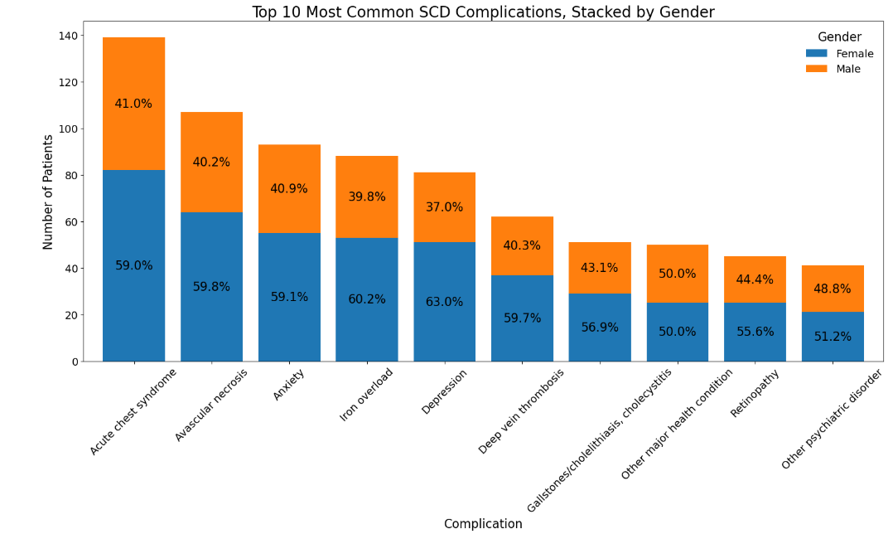
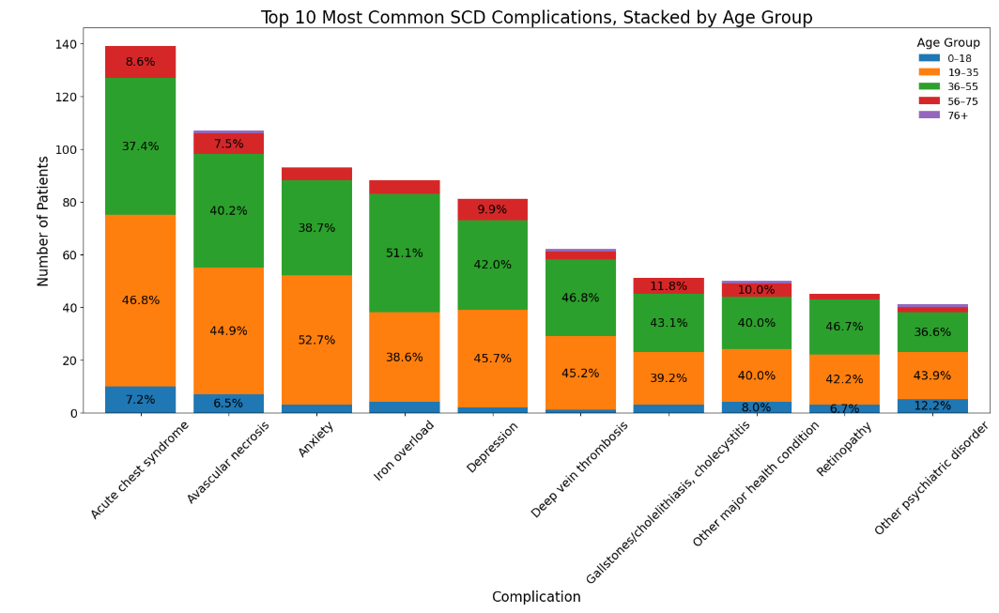
Top 10 Most Common SCD Complications
Top 10 Most Common SCD Complications, Stacked by Gender
Top 10 Most Common SCD Complications, Stacked by Age Group
Insights:
Acute chest syndrome is the single most common complication, affecting more patients than any of the other top-10 complications.
For nearly every top complication, women make up about 60% of cases—showing a consistent female majority across SCD comorbidities.
Depression exhibits the largest gender gap: roughly 63% of patients with depression are female.
Insights:
Young adults (19–35) bear the brunt of nearly every complication, making up about 45–53% of cases across the top 10.
Middle age (36–55) is the second most affected cohort—over half of iron overload and roughly 42% of depression cases fall in this group.
Children (0–18) and seniors (56+) account for under 10% of most complications, with the lone exception of psychiatric disorders where kids make up ~12%.

Slide 6
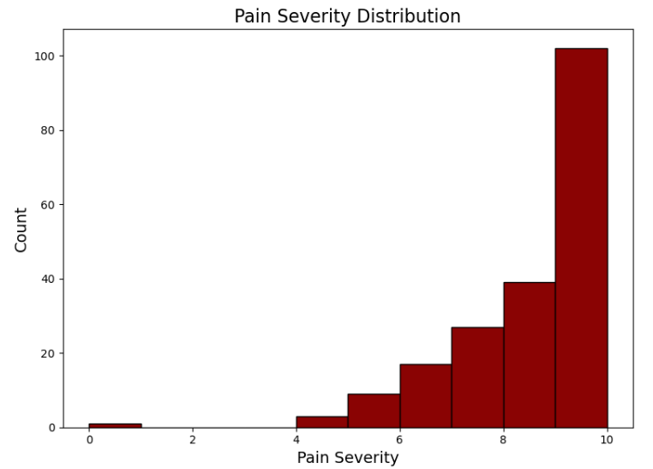
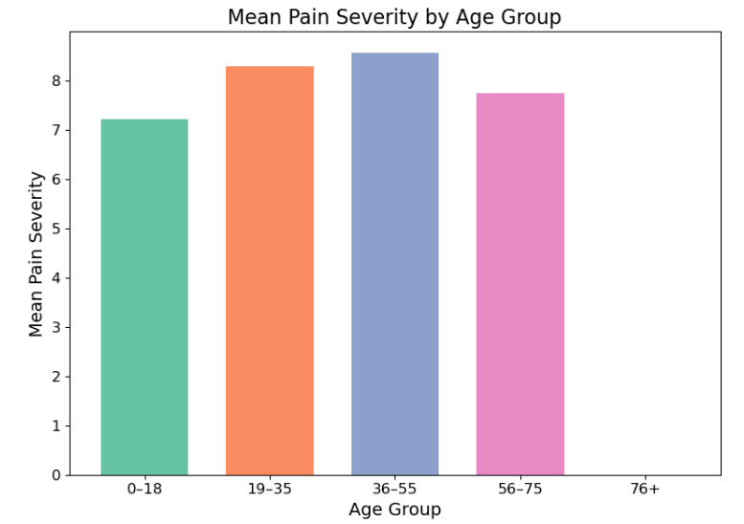
Pain Severity
Pain Severity Distribution
Mean Pain Severity by Age Group
Insights:
Pain score 10 is by far the most common, followed by 9, showing extreme pain dominates.
Scores 5–8 occur less often, indicating moderate pain is secondary.
Very few patients report low pain (< 4), so minimal discomfort is rare.
Insights:
Adults aged 36–55 endure the most pain, with an average severity around 8.5.
Young adults (19–35) closely follow at 8.3, while seniors (56–75) drop to about 7.8.
Children (0–18) report the least pain (≈7.2), and the 76+ group has too few cases to show reliably.

Slide 7
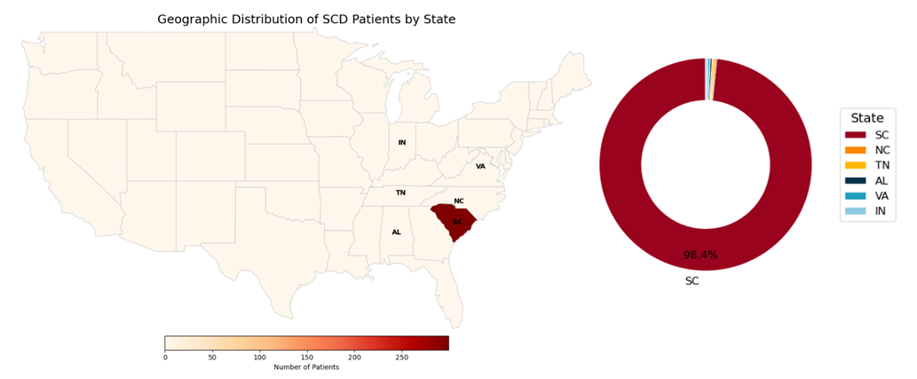
Distribution of Patients by States
98.4%
South Carolina accounts for roughly 98.4% of our patient cohort, while all other states combined make up just 1.6%. To streamline our analysis and ensure robust weather coverage, we’ll export NOAA weather data for South Carolina only.

Slide 8
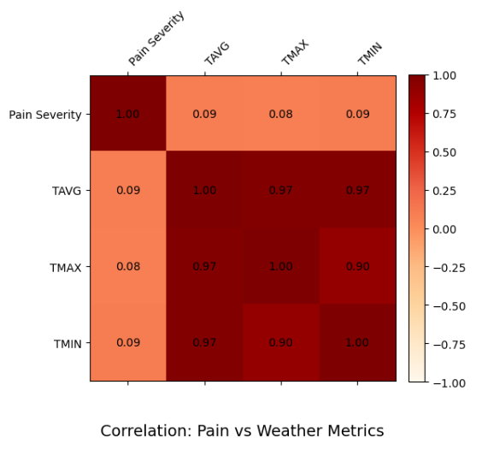
Correlation: Pain vs. Weather Metrics
Correlation: Pain vs. Weather Metrics
Temperature measures show a weak relationship with pain severity with only 0.8-0.9 correlation coefficient.
Framing The Hypothesis
H₀ (Null): The mean pain severity during cold temperature equals the mean pain severity during warm temperature.
H₁ (Alternative): The mean pain severity during cold temperature is greater than the mean pain severity during warm temperature.

Slide 9
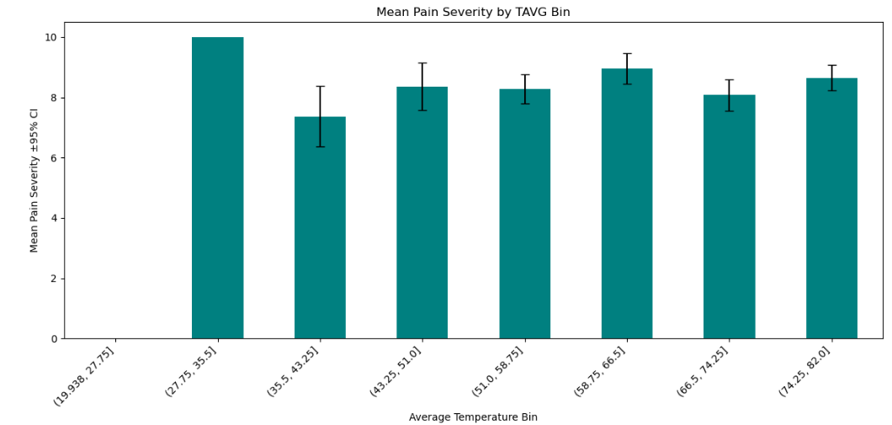
Mean Pain Severity by Average Temperature Bin
Insights:
Patients experience the highest average pain in both coldest and hottest temperature bins.
Hence, We fail to reject the Null Hypothesis.
What Went Wrong ?
Event Date Misalignment: We used each patient’s registration date as the “pain event” date instead of their actual crisis dates.
Delayed Reporting: Some patients suffered severe pain 2–3 weeks before registering, so the weather on registration day doesn’t reflect the true trigger.
Action: We need accurate crisis timestamps to correctly link temperature and pain.

Slide 10
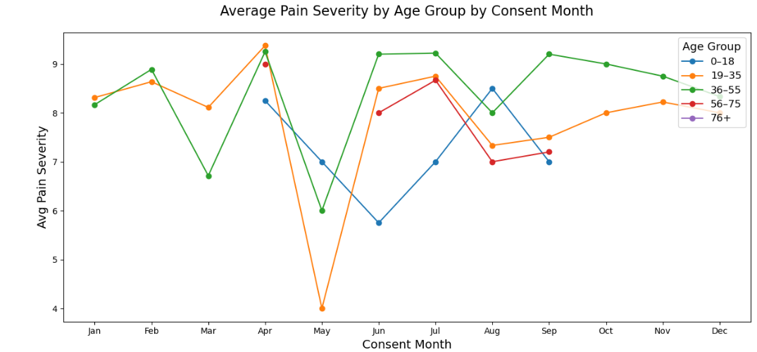
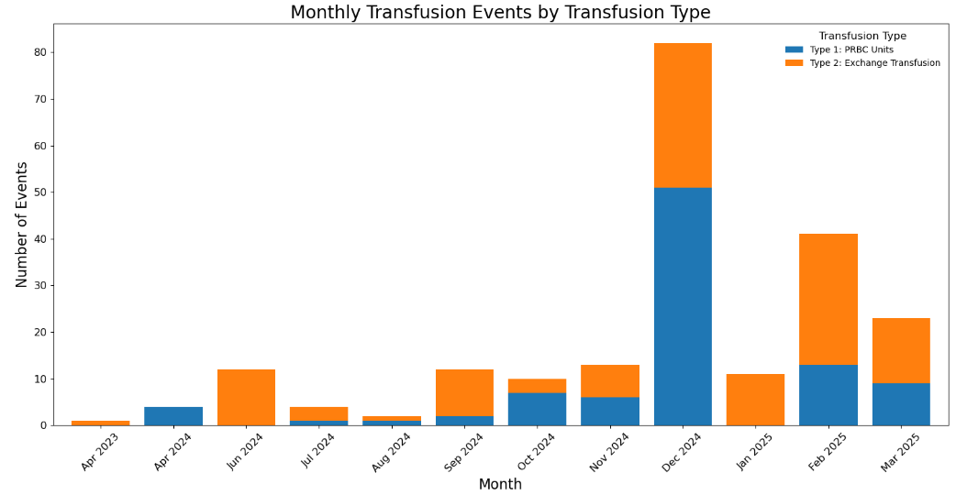
Seasonality Check
Average Pain Severity by Age Group by Consent Month
Monthly Transfusion Events by Transfusion Type
Insights:
Winter (Dec–Feb) sees the highest average pain across all age groups.
Pain drops to its lowest during summer (Jun–Aug).
Every age group hits its highest average pain in April, 19–35 and 36–55 age groups spike above 9 out of 10.
The 36–55 age group stays consistently high (above 8) across all months, showing the least seasonal relief.
Insights:
Transfusions peak sharply in December 2024 (over 80 events), driven mostly by PRBC units.
Early 2025 (Feb–Mar) shows a secondary surge, where exchange transfusions outnumber PRBC units.
Summer months (Jun–Aug) see very few transfusions (under 5 per month).

Slide 11

Recommendations
Incorporate gender- and age-specific messaging (e.g. extra support for females and 36–55 year old age group).
Prioritize outreach and educational resources in South Carolina and North Carolina during winter.
Integrate alerts into the sponsor’s virtual assistant (“Sallie”) for real-time patient notifications.
Provide winter-focused self-care guides (hydration, warmth strategies) alongside alerts.
Coordinate with local clinics to prepare for increased winter demand.
Future Scope
Collect and integrate true pain-crisis timestamps (e.g. mobile app logging).
Build and validate a predictive model using weather + demographics + comorbidities.
Expand weather features to include humidity, barometric pressure, and air quality.
Develop an interactive dashboard with maps and time-series views for clinicians.

Slide 12
Report Summary
Pain Severity Distribution: Seen as a right-skewed curve with most scores between 4–8 and ~15% at the worst level (10), highlighting overall high pain burden.
Mean Pain by Age Group: The 36–55 cohort reports the highest average pain (~6.8), followed by 19–35 (~5.9) and 56+ (~6.3), pinpointing midlife as most vulnerable.
Pain Frequency by Gender: Females exhibit “Often” pain in ~60% of cases vs. ~45% in males, indicating more frequent crises among women.
Top-10 Complications by Gender & Age: Acute chest syndrome and avascular necrosis are the most common; depression skews female (~63%), and retinopathy rises notably in older groups.
Geographic Distribution: South Carolina (~98.4% of patients) and North Carolina (~1.6%) dominate, making SC the primary focus for interventions.
Correlation Heatmap: Temperature metrics (TMIN, TMAX, TAVG) move together but each shows only a very weak link to pain when using registration dates.
Seasonality (Consent Month): Winter (Dec–Feb) peaks pain severity; summer (Jun–Aug) brings relief; an April/May spike highlights proxy-date misalignment.
Transfusion Events by Month: PRBC and exchange transfusions surge in winter (Dec–Feb) and drop in summer, mirroring pain seasonality.
TAVG Bin Analysis: Pain is highest at the coldest and hottest average-temperature extremes, dipping in moderate ranges—underscoring nonlinear weather effects.
Conclusion
Our exploratory analysis of merged SCD and weather data reveals that winter months (Dec–Feb) coincide with peak pain severity and transfusion events, especially among mid‐aged (36–55) and female patients. South Carolina emerges as the primary hotspot, accounting for 98.4% of the cohort. Initial temperature–pain links were confounded by registration-date misalignment, so we used consent-month proxies to validate seasonal effects. In the next phase, we will build predictive models and implement actionable weather-based alerts for proactive patient care.

Slide 13

Q/A
Open Discussion

Slide 14
References
Power of Patients. (n.d.). Retrieved April 16, 2025, from https://www.powerofpatients.com
Statology. (n.d.). Pandas wide to long. Retrieved April 16, 2025, from https://www.statology.org/pandas-wide-to-long/
GeeksforGeeks. (n.d.). Exploratory data analysis in Python. Retrieved April 16, 2025, from https://www.geeksforgeeks.org/exploratory-data-analysis-in-python/
Nussbaumer Knaflic, C. (2015). Storytelling with data: A data visualization guide for business professionals
National Centers for Environmental Information. (n.d.). Climate data online search. Retrieved April 16, 2025, from https://www.ncei.noaa.gov/cdo-web/search

Slide 15
THANK YOU!

